Slide 1
Income Prediction

Slide 2
Problem Statement
Many Non-Profitable organizations try to help the poor. They mainly survive on donations. They often go to various places and put a request for donations. So, we are trying to help such organizations in predicting the salary of the person they will be visiting for the request so that they can ask for a proper amount in the request.

Slide 3
Objective
We will then choose the best candidate algorithm from preliminary results and further optimize this algorithm to best model the data. Our goal with this implementation is to build a model that accurately predicts whether an individual makes more than $50,000.

Slide 4
DATA SUMMARY
Rows: 48842
Columns: 15
Variables:
Age
Workclass
Fnlwgt
Education
Educational_num
Marita_lstatus
Occupation
Relationship
Race
Gender
Capital_gain
Capital_loss
Hours_per_week
Native_country
Income

Slide 5
Exploratory Data Analysis

Slide 6
Missing Values
In total we have 3620 rows with some missing values
That is approximately 7% of the rows have some missing values
Columns Containing Missing values:
Work class
Occupation
Native country

Slide 7
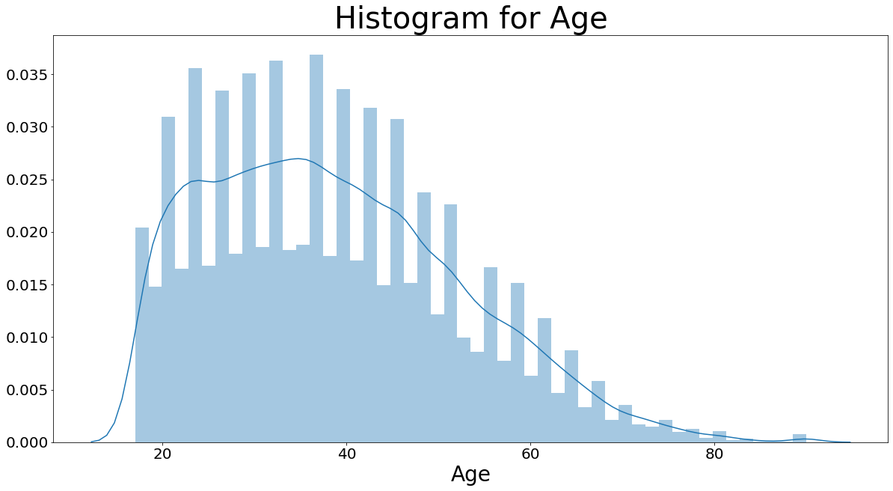
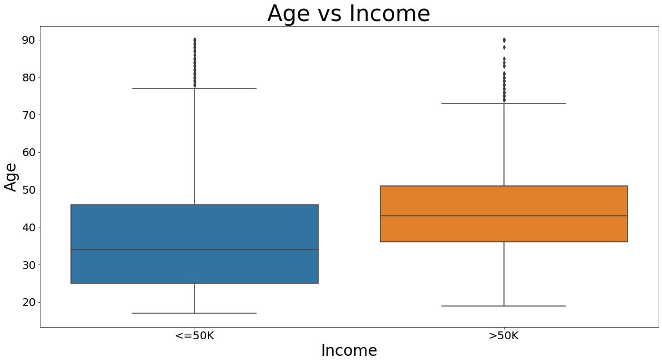
Age
Skewness: .55(moderately skewed)
We can see that higher-income category have higher age

Slide 8
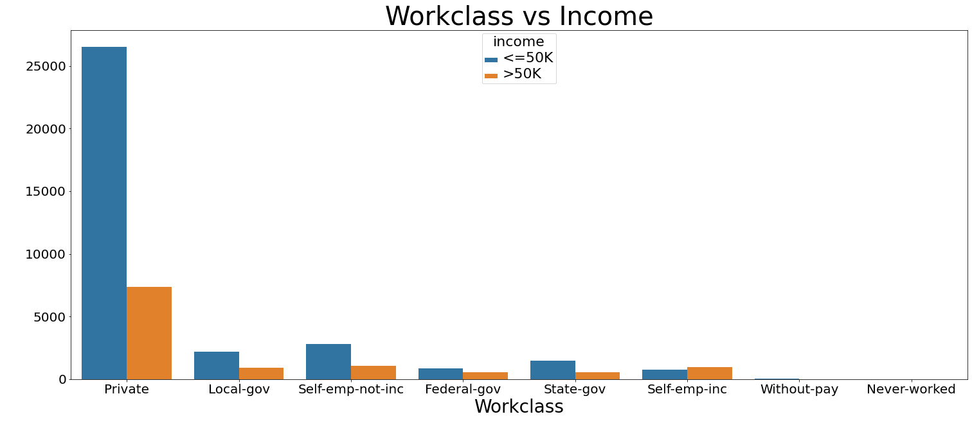
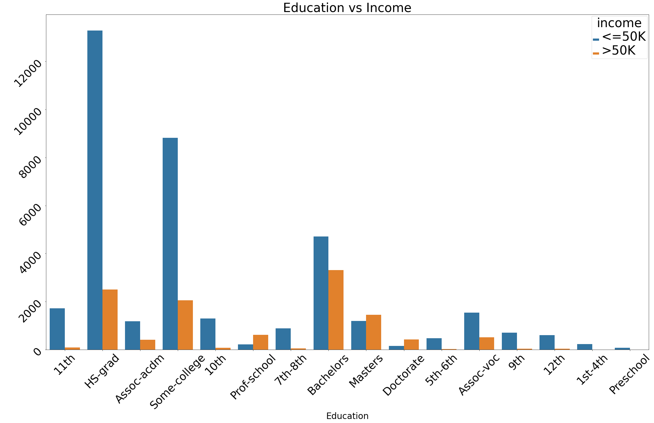
Work class and Education
We can make a note that if the person is self employed,
it has higher chance of having salary more than 50K.
When the education is moving towards the advance level, the salary is high

Slide 9
Educational_num
educational_num | <=50k | >50
1 | 0.987952 | 0.012048
2 | 0.967611 | 0.032389
3 | 0.946955 | 0.053045
4 | 0.935079 | 0.064921
5 | 0.945767 | 0.054233
6 | 0.937365 | 0.062635
7 | 0.949227 | 0.050773
8 | 0.926941 | 0.073059
9 | 0.841422 | 0.158578
10 | 0.810351 | 0.189649
11 | 0.746725 | 0.253275
12 | 0.742036 | 0.257964
13 | 0.587165 | 0.412835
14 | 0.450884 | 0.549116
15 | 0.260192 | 0.739808
16 | 0.274411 | 0.725589
As we have high educational_num, the percentage of population getting salary greater than 50K is increasing

Slide 10
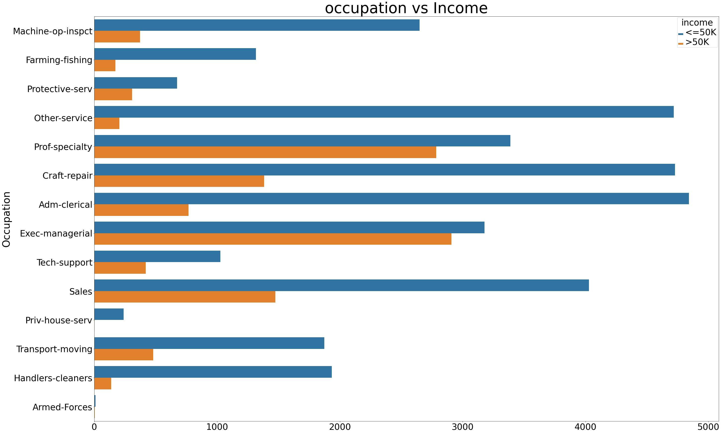
Occupation
If we are visiting them, We can put a request with high amount.

Slide 11
Relationship and Gender
income | <=50K | >50K
relationship
Husband | 0.551329 | 0.448671
Not-in-family | 0.898593 | 0.101407
Other-relative | 0.965471 | 0.034529
Own-child | 0.985358 | 0.014642
Unmarried | 0.939707 | 0.060293
Wife | 0.531103 | 0.468897
income | <=50K | >50K
gender
Female | 0.890749 | 0.109251
Male | 0.696233 | 0.303767
Males are earning more
Husbands and wife are earning more

Slide 12
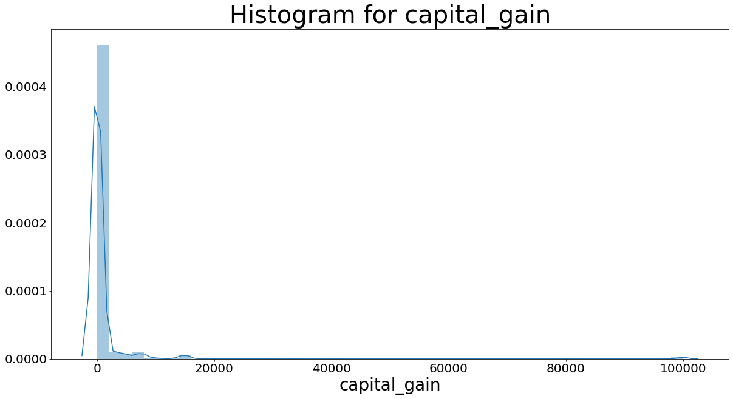
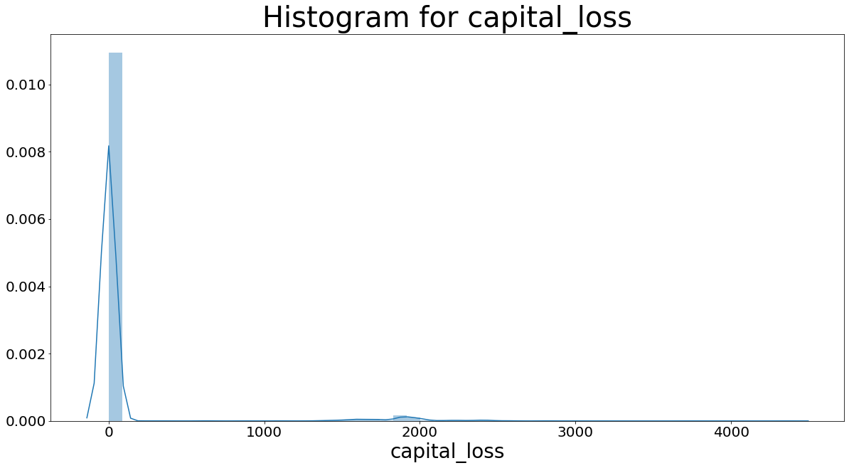
Capital gain and capital loss
Both are highly skewed
So we will take the log transformation for both the variables

Slide 13
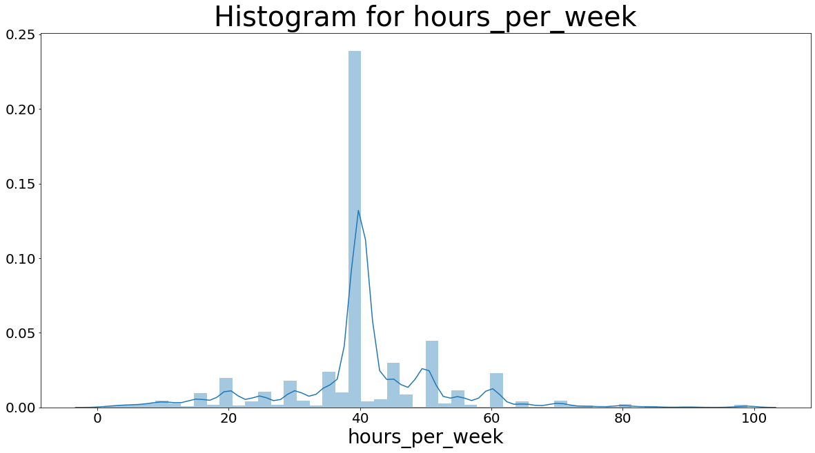
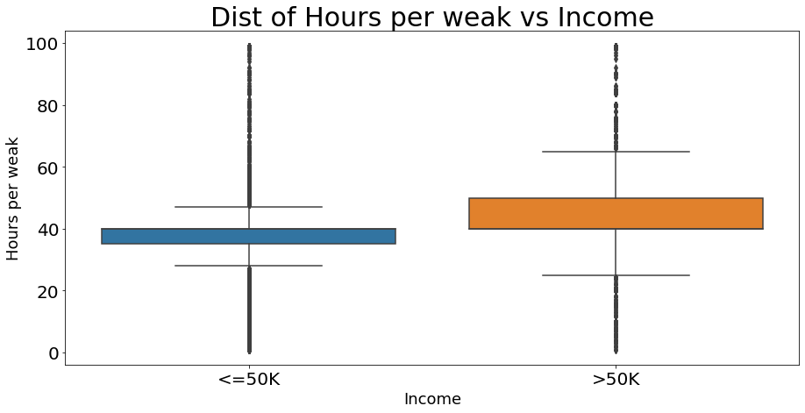
Hours per Week
Work time is more where person is earning >50

Slide 14
Modelling

Slide 15
Predictive Accuracy
Model | Accuracy
Decision Tree(Including every Variable) | .86
Decision Tree(removing education,workclass,maritial status and occupation) | .85
AdaBoost Classifier | .87
RandomForestClassifier | .84

Slide 16
Conclusion
As we can see, most of the models have somewhat similar accuracy. So I will go with the decision tree model as it is easy to interpret.
GitHub link: https://github.com/indrajit3260007/Salary-Prediction-Classification-Problem-/blob/master/Income%20prediction(Classification%20Problem).ipynb

Slide 17


